Slide 1
Local Multi-Head Channel Self-Attention for Facial Expression Recognition
Pratik Shetty
Guide : Prof. C. Krishna Mohan
TA : Khin Cho Win

Slide 2
Outline
Recap of the First Presentation
Problem Statement
Channel-wise Attention Vs. Spatial Attention
Approach
Advantages
Conclusion
References

Slide 3
Recap of the First Presentation
Problem statement
Novel self-attention module that can be easily integrated into virtually every Convolutional Neural Network (CNN).
That is specifically designed for computer vision, the Local (multi) Head Channel (Self-Attention) (LHC Self-Attention).

Slide 4
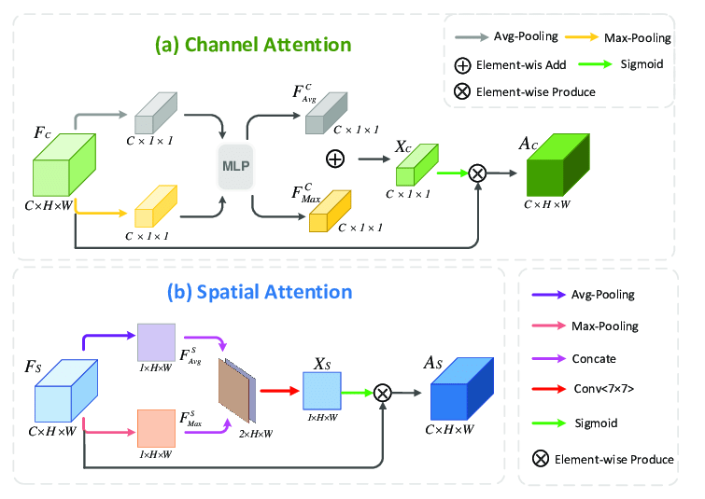
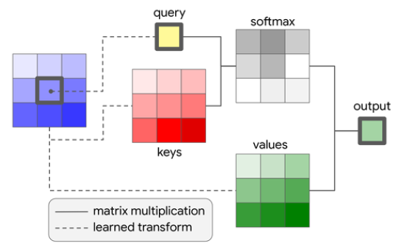
Recap of the First Presentation (Cont’d)
Channel-Wise Attention Vs. Spatial Attention
Channel-wise self-attention is better than spatial attention.
Figure: Self-Attention

Slide 5
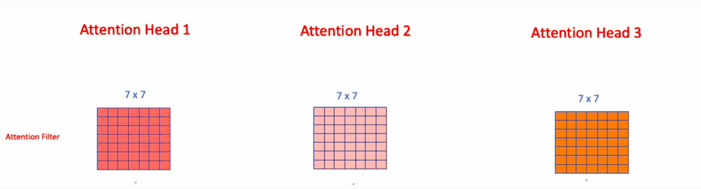
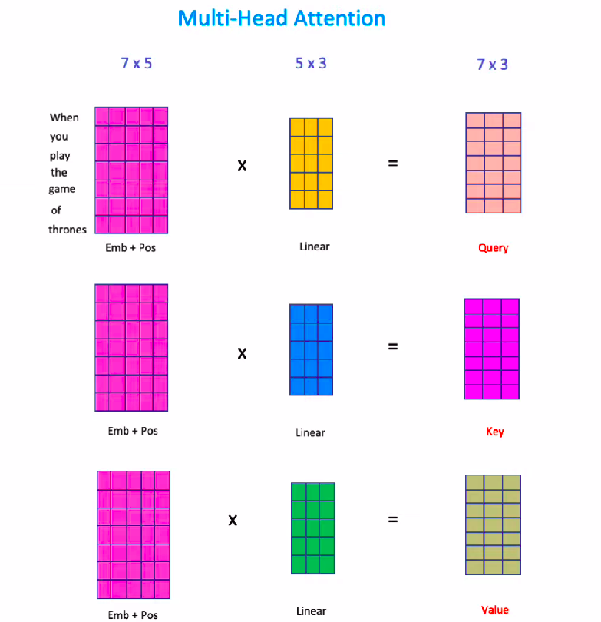
Recap of the First Presentation (Cont’d)
Multi Head Self-Attention in Transformer
Multiple Attention matrix is generated using the same input.
Figure: Multi-Head Self-Attention

Slide 6
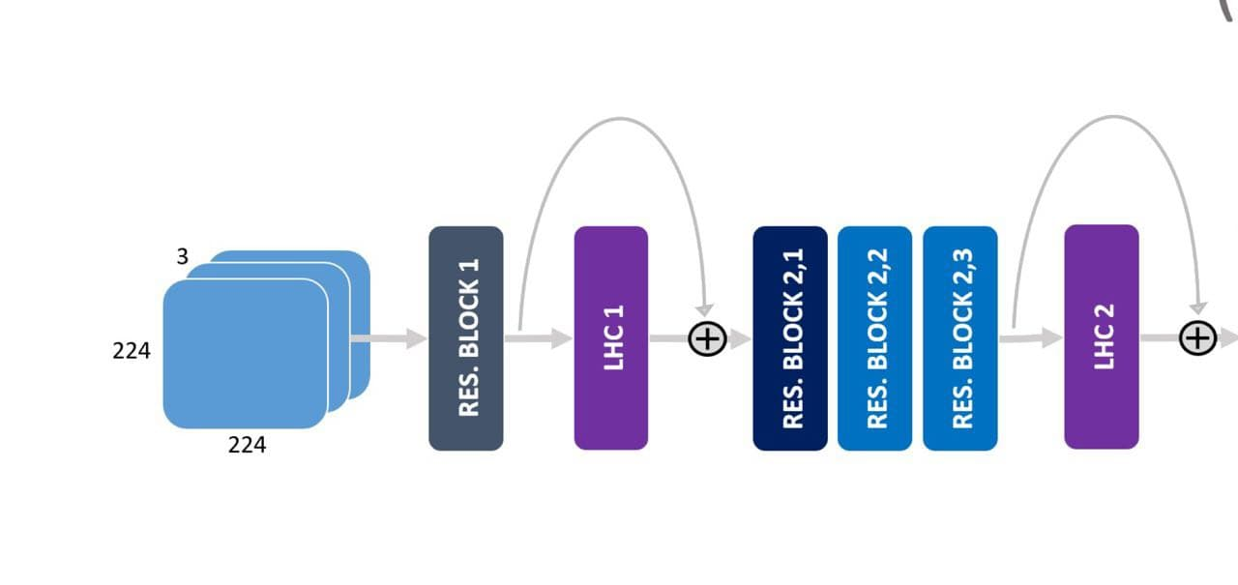
Recap of the First Presentation (Cont’d)
LHC-net modules are integrated with existing neural network architecture having backbone as convolutional neural network.
Figure: LHC-net integration with ResNet34v2 architecture.

Slide 7
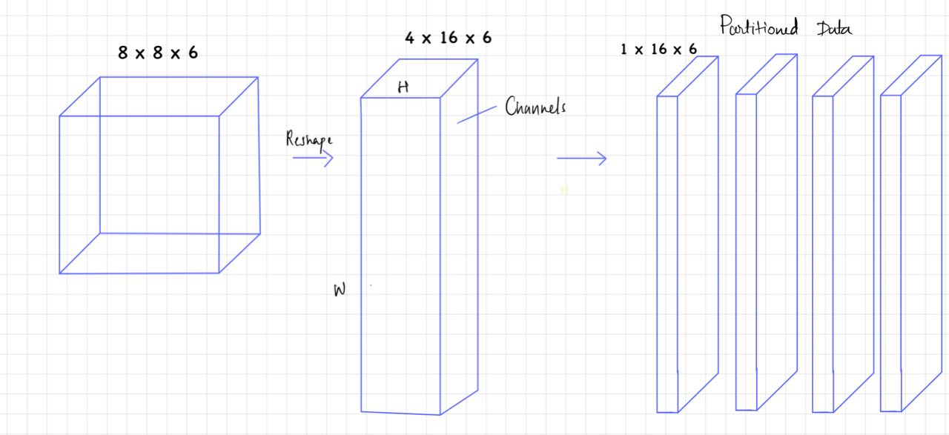
LHC Module Architecture (Cont’d)
Data processing in Local Multi-Head Self-Attention
Splitting the input data into multiple Heads
Figure: Splitting Input Data

Slide 8
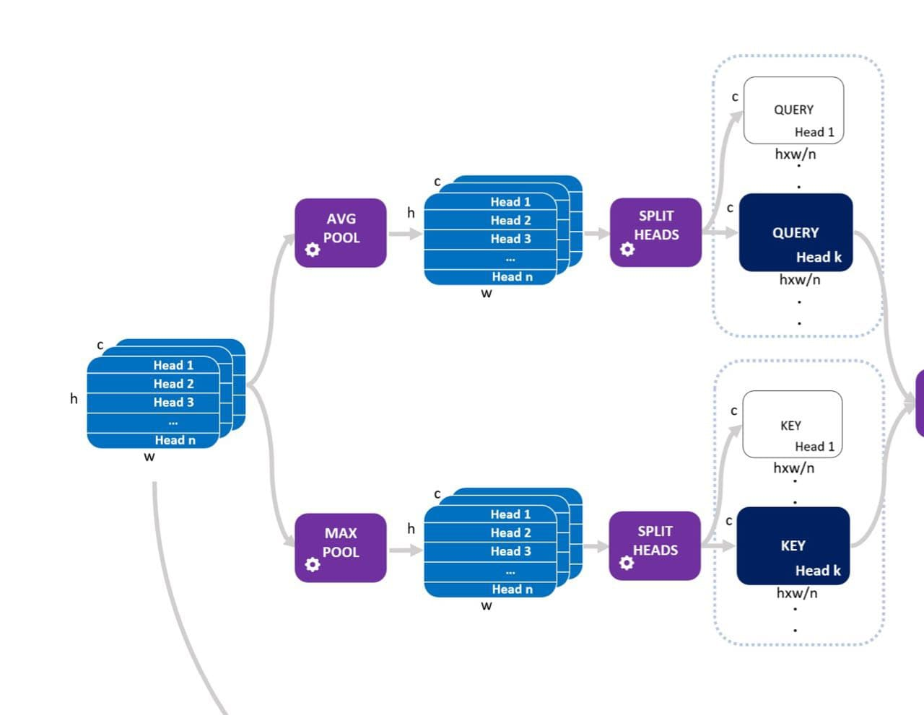
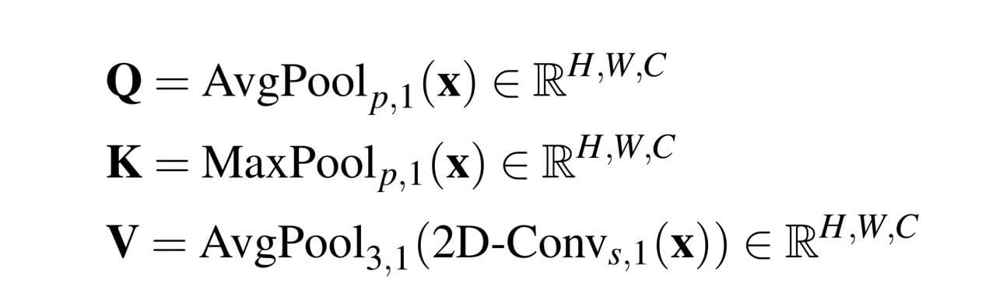
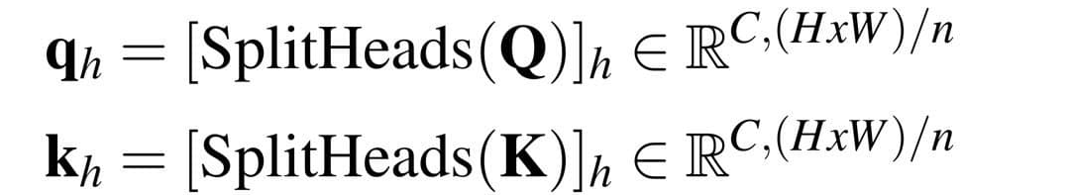
LHC Module Architecture (Cont’d)
A generic input tensor is processed to get Q(query) and K(key) tensors.
The tensors Q and K are splitted into n horizontal slices.
The resulting tensors are reshaped.

Slide 9
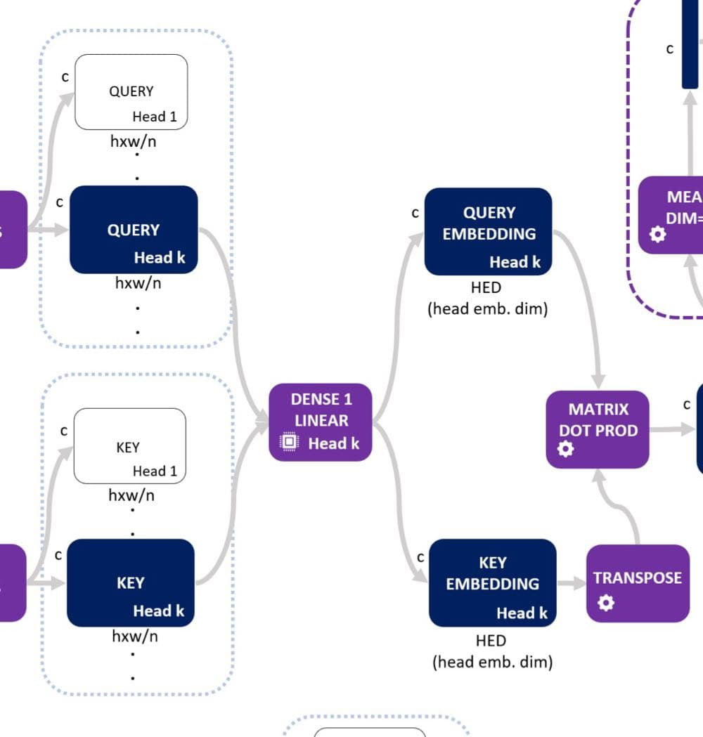
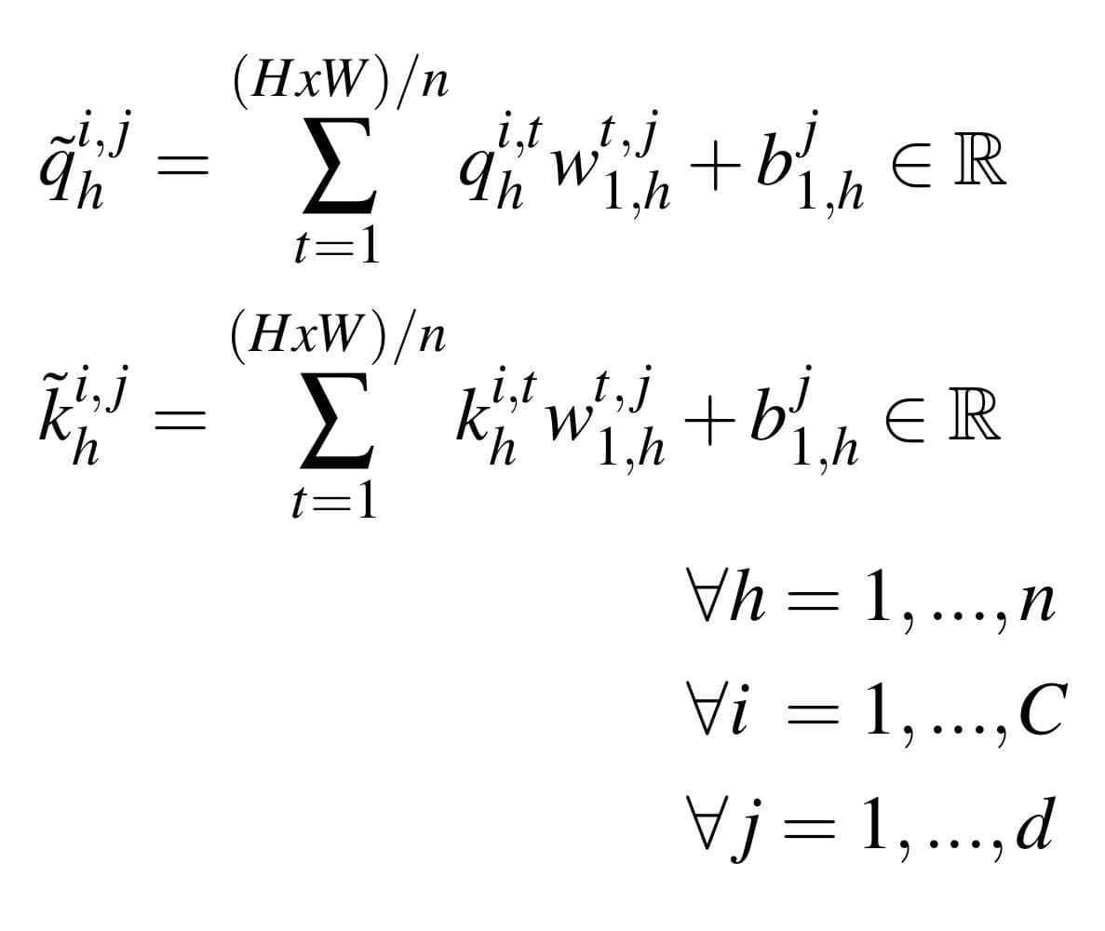
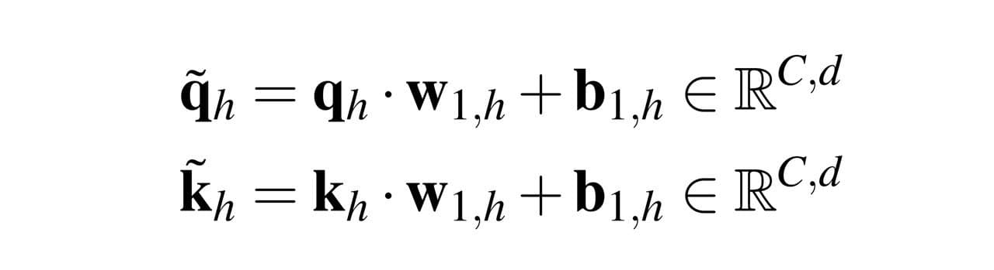
LHC Module Architecture (Cont’d)
Query and key will share the same dense blocks resulting in n embeddings as follows:

Slide 10
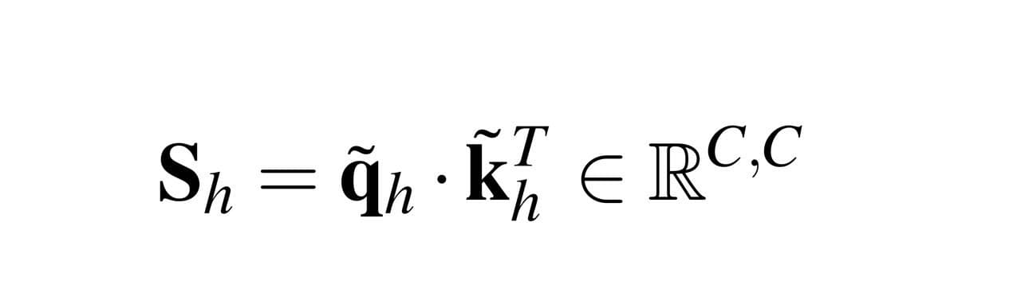
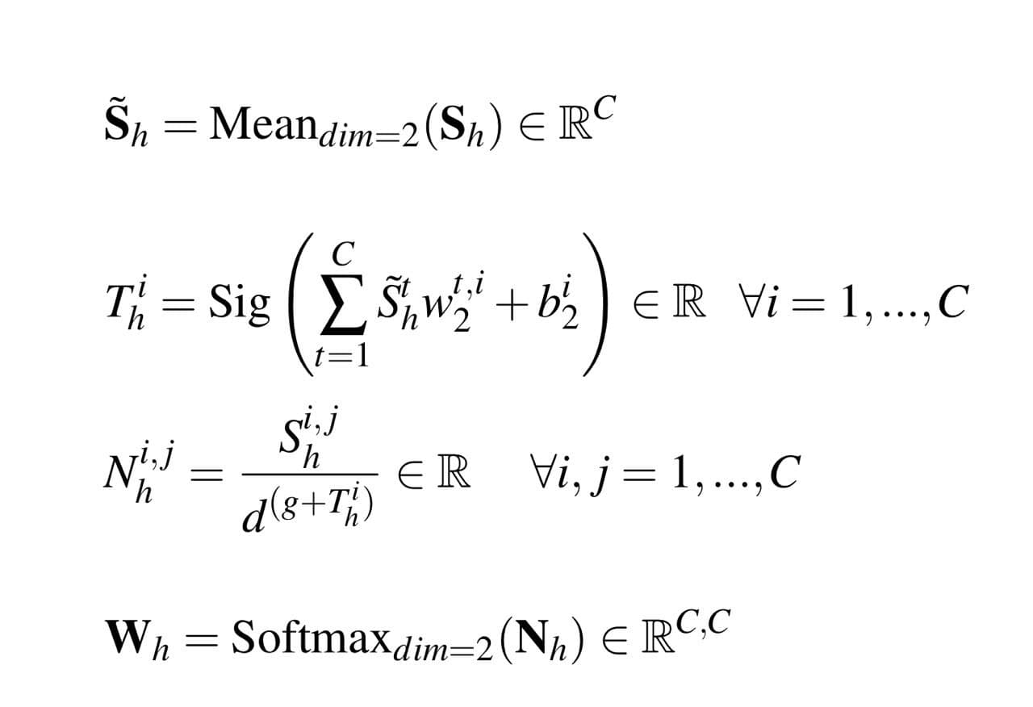
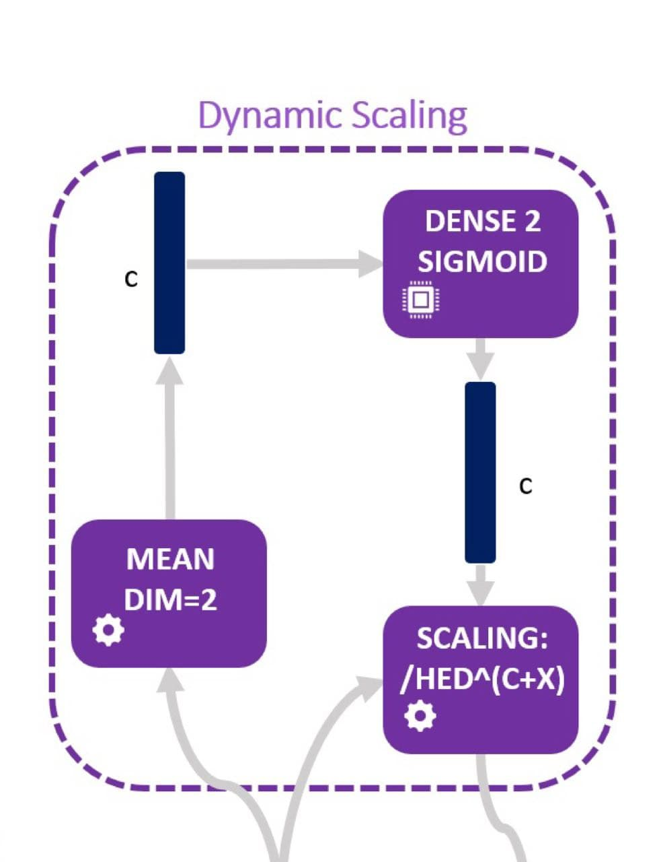
LHC Module Architecture (Cont’d)
The attention scores (S_{h}) are calculated.
Dynamic Scaling : It produces a channel-wise learned scaling (not dependent on heads) by averaging the scores and passing them through another fully connected layer with sigmoid activation and weights/biases.

Slide 11
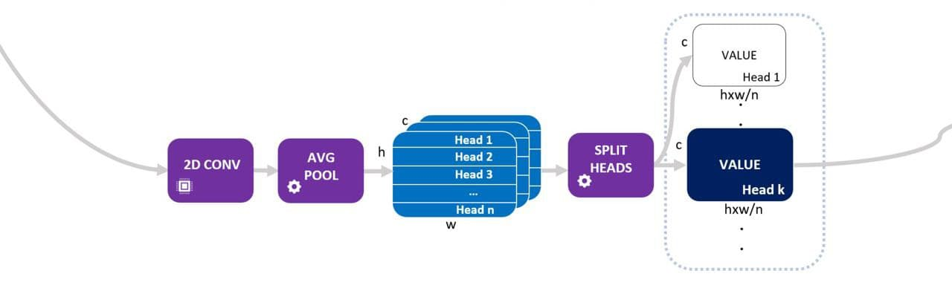
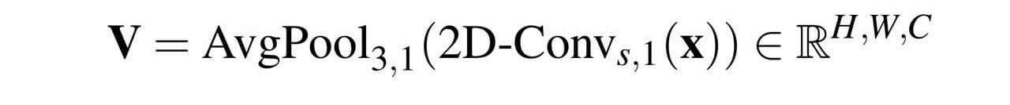
LHC Module Architecture (Cont’d)
Generating V(value) tensor :

Slide 12
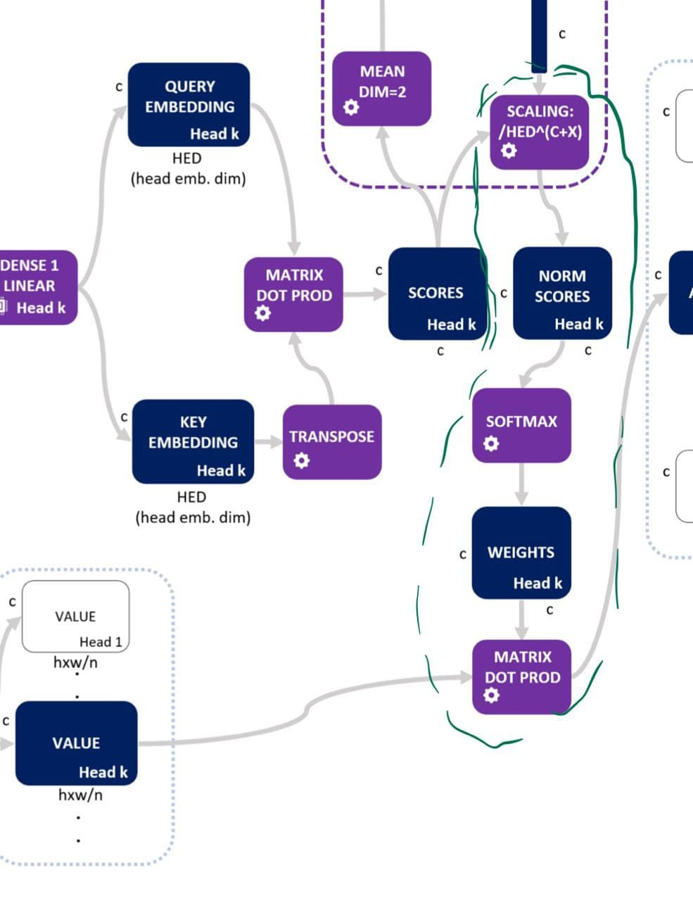
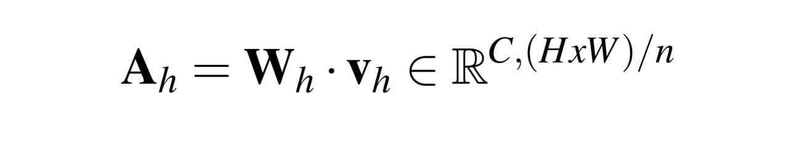
LHC Module Architecture (Cont’d)
The final attention vector for head h :

Slide 13
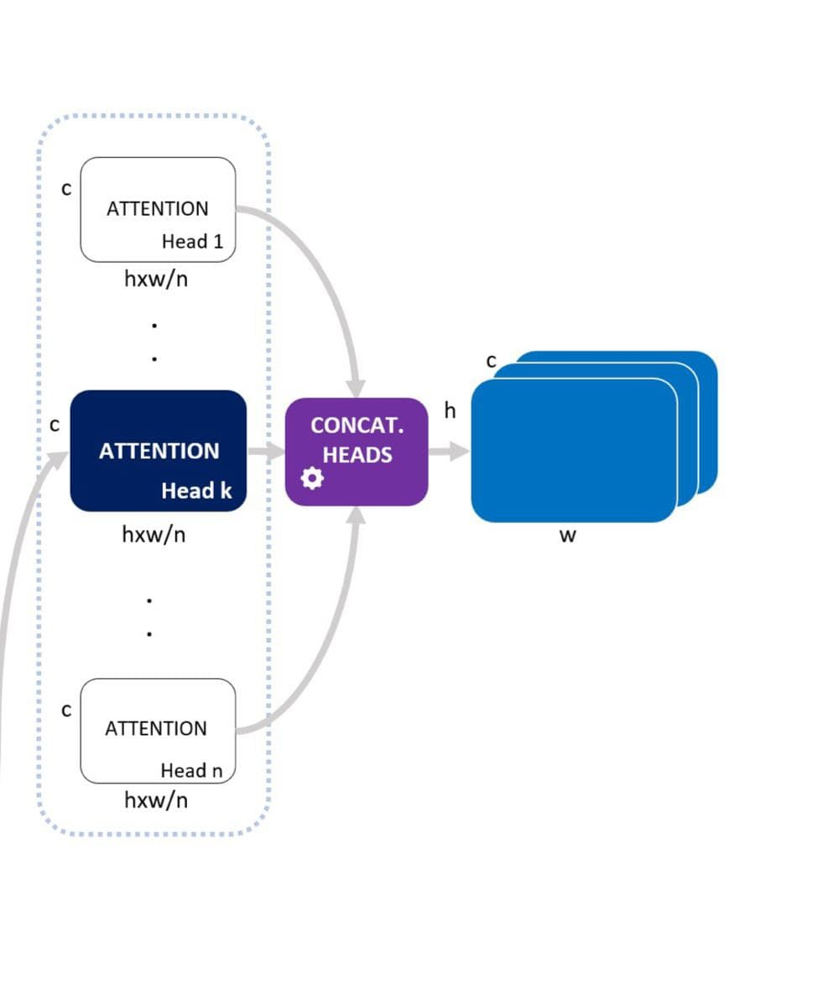
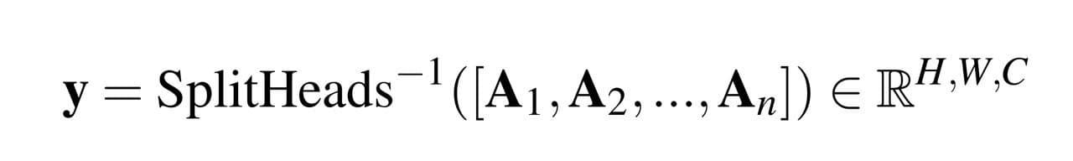
LHC Module Architecture (Cont’d)
Finally, we assemble then heads to get the final output y :

Slide 14
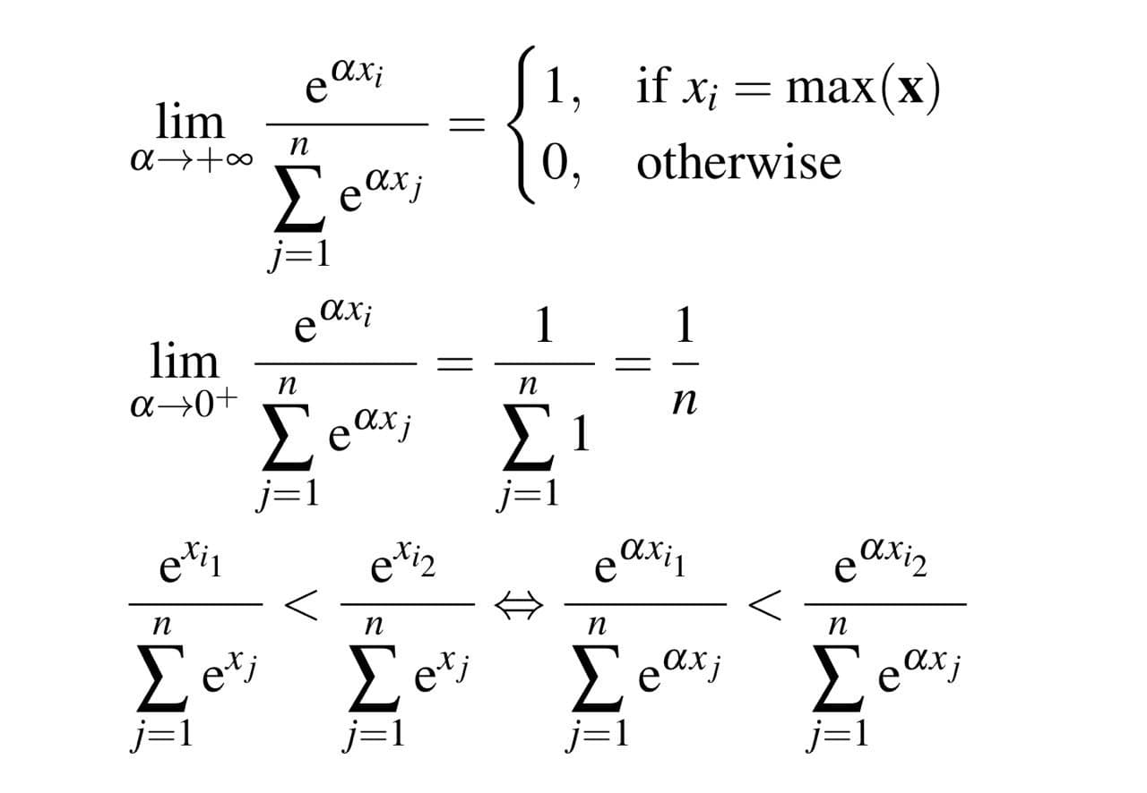
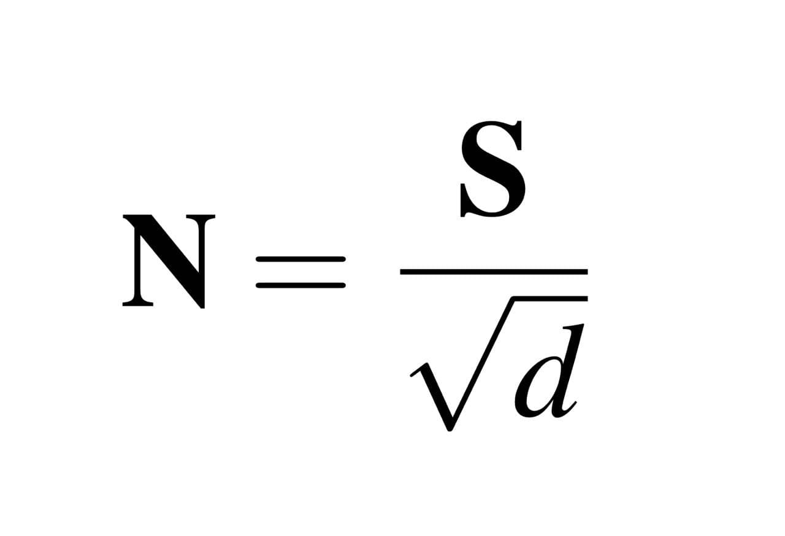
Advantages
Channel Self-attention : Improves on spatial attention which assumes the relationship pixels or areas of image exists.
Dynamic Scaling : Dynamic scaling module learns how complex the new feature maps must be.

Slide 15
Advantages (Cont’d)
Local Multi-head
Detecting a pattern of a few pixels is harder if the input includes the entire feature map.
Splitting the images into smaller parts gives local heads the ability to build new feature maps considering only the important parts of the old maps.

Slide 16
Experimental Analysis and Finding

Slide 17
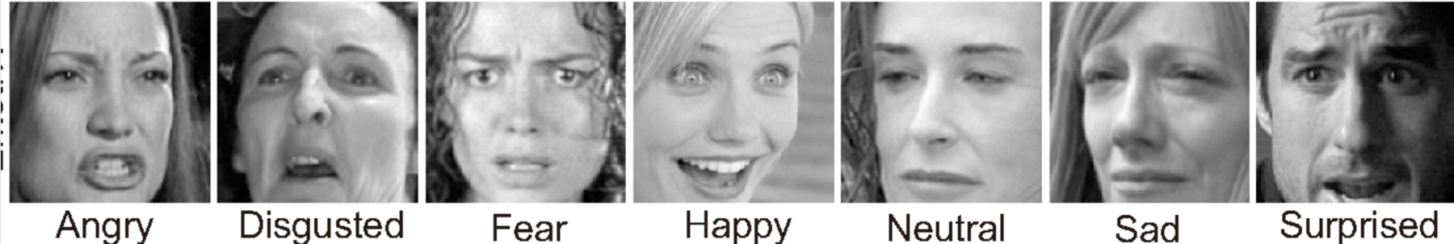
Dataset Description
FER 2013
The object of a 2013 Kaggle competition
35587 grey-scale 48x48 images of faces
7 categories: anger, disgust, fear, happiness, sadness, surprise, neutral.
a challenging dataset: noisy data with a relatively large number of non-face images and misclassifications and strongly unbalanced

Slide 18
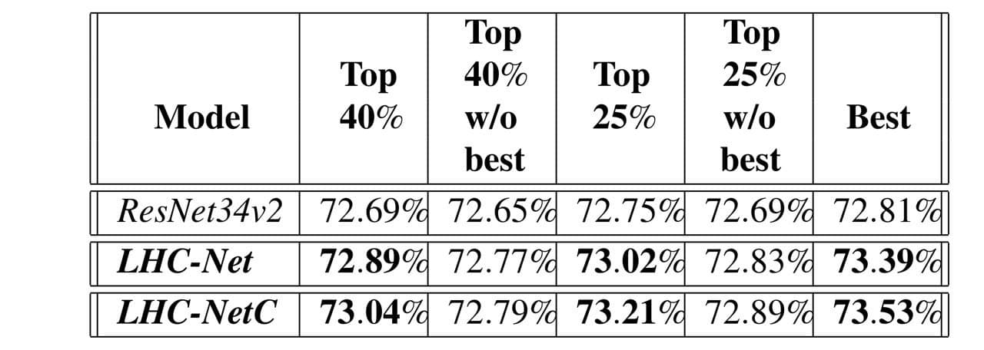
Performance Measures

Slide 19
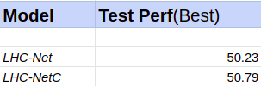
Implementation Details
The implementation was done using Tensorflow Library.
Pre-trained Resnet34 model was used as backbone for this module.
The test/train was done on system with 16Gb RAM and NVIDIA 1650 GPU.
The following test was done after training on limited dataset(6k images).

Slide 20
Finding
LHC-Net was able to consistently outperform our best performing ResNet34v2, both on average and on peak result.
LHC-Net has the top accuracy both with and without testing time augmentation (TTA).
LHC-NetC outperforms LHC-Net but is outperformed when TTA is used.

Slide 21
Novelty
The current architecture doesn’t have any part which is specifically designed for facial expression recognition.
Unlike most image classification system facial recognition has dependencies on neighbouring pixels ie. the expression of eyes and lips have dependencies for a particular emotion.
Hence, in this case the spatial self attention can also be used instead of local multi-head attention.
One of the drawback of this change is the computational complexity will increase. Hence in the ResNet34 integration only the 1st LHC module is changes to spatial.

Slide 22
Novelty (Contd)
Changes :
The first LHC module is updated to spatial self-attention module.
In the LHC architecture to generate the Key, Value and Query all the input data will be used instead.
Number of heads for this module is set to 4 instead of 8

Slide 23
Conclusion
The LHC-net module has proved channel self-attention in synergy with convolution could be a functioning paradigm by setting a new SOTA on well known dataset FER2013.
It has been shown that self-attention works well as a small attention module intended as a booster for pre-existing architectures.

Slide 24
References
Pecoraro, Roberto, et al. “Local Multi-Head Channel Self-Attention for Facial Expression Recognition.” arXiv preprint arXiv:2111.07224 (2021).
Alexey Dosovitskiy, et al. “An Image is Worth 16x16 Words: Transformers for Image Recognition at Scale”
https://towardsdatascience.com/transformers-explained-visually-part-3-multi-head-attention-deep-dive-1c1ff1024853
https://www.kaggle.com/residentmario/transformer-architecture-self-attention
http://jalammar.github.io/illustrated-transformer/
https://www.kaggle.com/msambare/fer2013
https://www.researchgate.net/figure/The-Attention-module-a-Channel-attention-module-MLP-Multilayer-perceptron-b_fig3_342725128
https://towardsdatascience.com/self-attention-in-computer-vision-2782727021f6

Slide 25
Thank You!

